Slide 1

Big Data Analytics in Mobile Telecom MS 7330: File Organization and Database Management
Paritosh Rai
ID: 47998747
SUPERVISED BY: Prof. Yasser Omar

Slide 2

Agenda
Introduction
Research Motivation
Background
Problem Statement
Research Objective
Literature Review 1
Literature Review 2
Literature Review 3
Conclusion

Slide 3
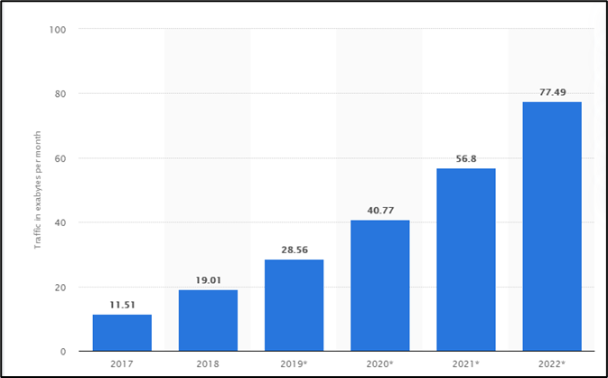
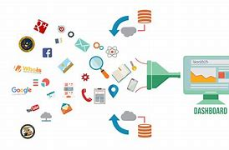
Introduction
Seven-Fold growth forecasted in Global mobile traffic between 2017 to 2022
There is an enormous growth of data traffic on the mobile network.
Data is generated in different forms, structured, unstructured, and semi-structured.
It is critical for Mobile Telecom Operators (MTOs) to harness the data generated by and on the network.
Build synergy among different data sources and build network growth strategy and marketing campaigns.
Network data
Customer data
Social media
Actionable Strategy

Slide 4



RESERCH MOTIVATION
Get the right tools and system to drive fast data-driven decision making with accuracy and actionable insight.
Mobile Operators
Network
Sales/MKT
Services
Leverage the data information to enhance the network and monetize
During COVID19, MTOs remodel, readjust, and re-evolve the network to accumulate the drastic change in customer data usage (type and location).

Slide 5
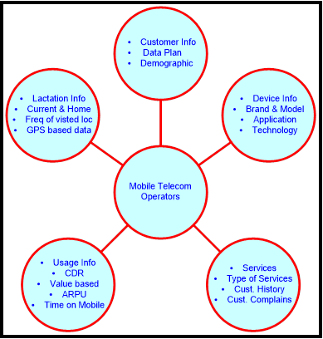
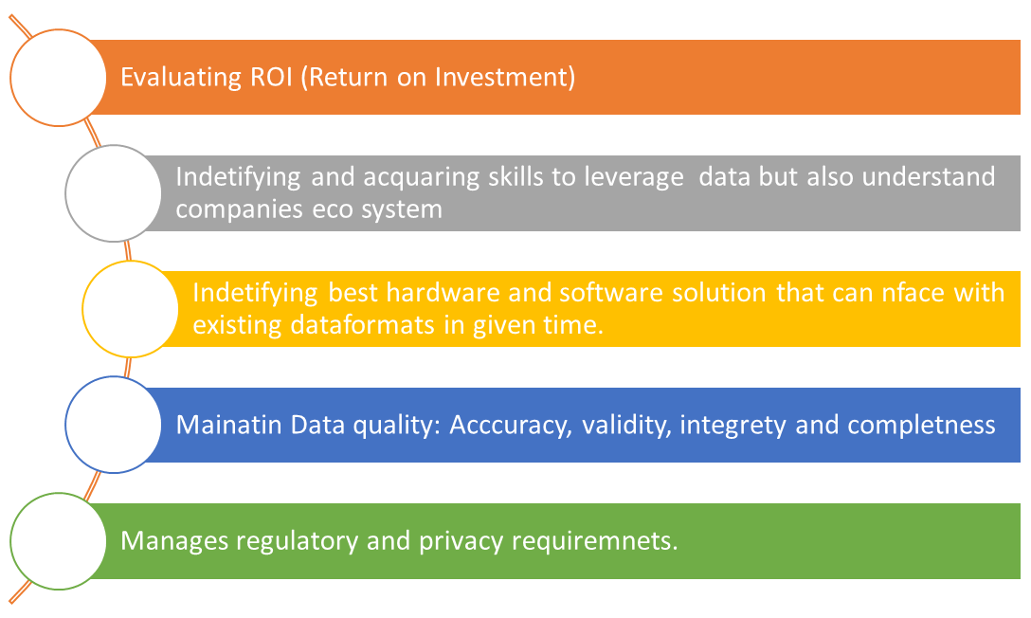
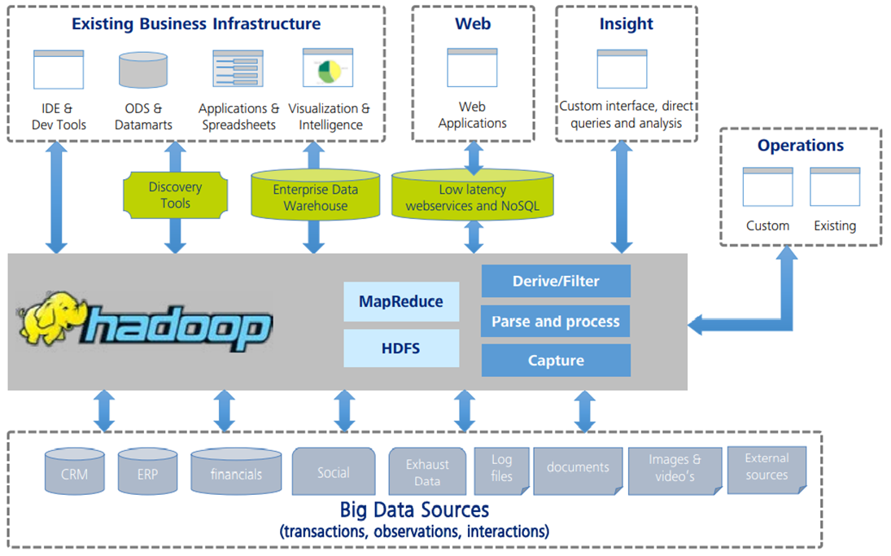
Background
Multiple data stream from multiple data sources throws multiple data challenges for MTOs.
Generate 5V if Big Data: Variety, Velocity, Volume, Veracity, and Value
Build a multi-layer Enterprise Data Architecture to process 5Vs of Big Data

Slide 6
Research Objective
Three key objectives of paper
This research aims to compare different models and find the Big Data Architecture that can be fastest, accurate, and provide a 360-degree view to optimize customer experiences leveraging multiple data sources.

Slide 7
LITERTURE REVIEW
The Research of Big Data Architecture on Telecom Industry (IEEE)
Big Data Analytics in Telecommunication using state-of-the-art Big Data Framework in a Distributed Computing Environment (IEEE)
Research on Telecom Big Data Platform of LTE/5G Mobile Networks (IEEE)

Slide 8
The Research of Big Data Architecture on Telecom Industry (IEEE) Authors: Fei Su, Yi Peng, Xu Mao, Xinzhou Cheng, Weiwei Chen
Advantage:
Open source fault-tolerant fast processing framework.
Leverages multiple tools to meet growing fast-evolving real-time data.
Objective of Paper
Technique Used
Paper discusses how to collect, parse, and analyze enormous data generated by the network and other sources to make a critical time-sensitive decision.
Dataset: CDR, OMC, twitter, GPS, Kafka, fumes …
Tools: Hadoop, Spark & Strom
•The paper discusses the adoption of an open-source framework.
•Hadoop Architecture is built with redundancy.
•Spark is used for fast and large-scale data processing
•Strom to process real-time data enabling scaling and fault tolerance
Disadvantage:
Can create interoperability challenges
No special tool for video processing. (video is 50% of data on telecom)

Slide 9
Big Data Analytics in Telecommunication using state-of-the-art Big Data Framework in a Distributed Computing Environment: A Case Study (IEEE) Authors: : Mohit Ved and Rizwanahmed B
Objective of Paper
Technique Used
Advantage:
Leverage multiple Machine learning Algorithm (ML).
Focus on Network tools and system to extract information.
Leverage multiple data mining techniques to process real-time data to find hidden and interesting patterns from telecom data.
Dataset: CDR: Call Detail Record
Tools: Rhadoop, R Statistical language and Apache Hadoop on super computing infrastructure of C-DAC
Applies Six step process Data Acq, Data Cleaning, Data Pre-Processing, Data Analysis, Data Visualization, and Data Discovery.
K-mean clustering is applied for clustering and predicting using several algorithms like Decision Tree, Random Forest, Logistic Regression, K-mean clustering.
Disadvantage:
Lack of discussion on other data sources like social media, twitter, etc.
Need little focus on semi-structured and unstructured data.

Slide 10
Research on Telecom Big Data Platform of LTE/5G Mobile Networks (IEEE) Authors: Lexi Xu , YueCao , Haochen Yang , Chen Sun , TaoZhang ,Binyuan Wen , XinzhouCheng , ChuntaoSong , Xin He
Objective of Paper
Technique Used
Advantage:
Architecture built keeping in mind 5G rollout.
Right balance of network and customer information.
Discuss the multi-layered big data architecture to process fast-flowing and changing information with evolving mobile technology leveraging network and customer data.
Dataset: CDR, OMC (config info), ecommerce
Tools: Hadoop, SQL Server, MySQL, No SQL (MongoDB), Spark, Map Reduce, Hive and Impala.
The paper discusses multiple techniques to get data ready for processing, including extraction, filtering (cleaning), transformation, and desensitization (for encrypted data).
Disadvantage:
Need discussion on IoT, OTT, and video as one of critical data sources.
Lack of processing of social media and geodata.

Slide 11
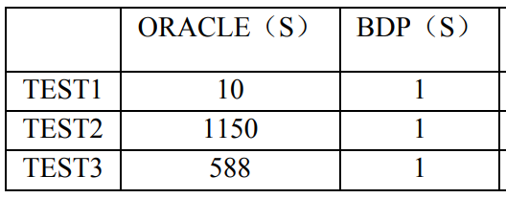
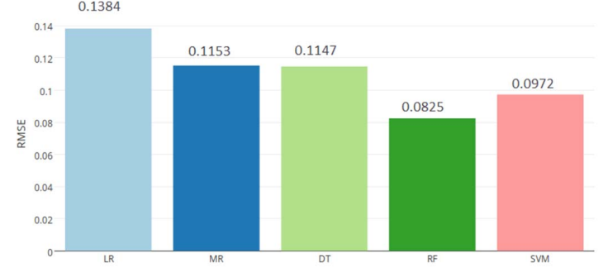
Conclusion
Three papers discussed here bring three different aspect of implementation of Big Data Platform:
❶ Tools ❷ Processing Technique ❸ Architecture
Paper 1
Paper 2
Paper 3
The paper focuses on Leveraging multiple tools to process the data to deliver a high processing rate.
Focuses on multiple data mining technique to process real-time data to find hidden and interesting patterns
Discusses multi-layered big data architecture to process fast-flowing and changing info with evolving technology
Performance: Average loading for Oracle is 1.2 MB/S vs. BDP is 10.7 MB/S.
BDP takes 1/10 of execution time than oracle or better.
Performance:
RHadoop outperforms R by factor of 2
Multiple Regression Accuracy of 62.6%
Random Forest gave best RMSE : 0.0825
Performance: No quantification but talks about reliable and high-efficient performance.

